Slide 1
FIT3143 Lab 1:
THREADS & OPENMP
Nam Tran and Julia Mallard

Slide 2
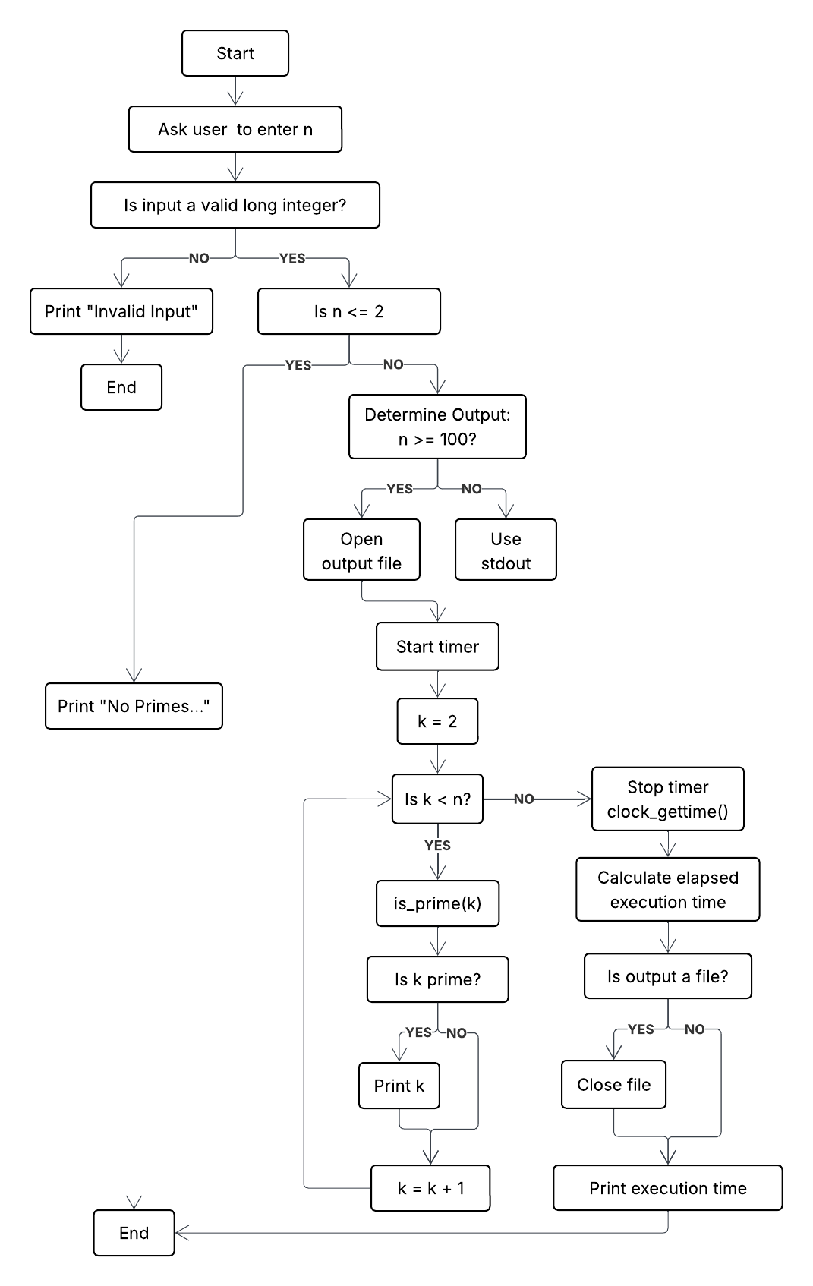
Task 1: Serial Prime Search
Iterates through every integer k strictly less than n, starting from 2.
Determines whether each k is prime using an is_prime(k) function.
Stores all identified prime numbers in an array.
Outputs the primes in ascending order, either to the terminal or a text file depending on n.
Measures execution time to provide a baseline for parallel speedup.

Slide 3
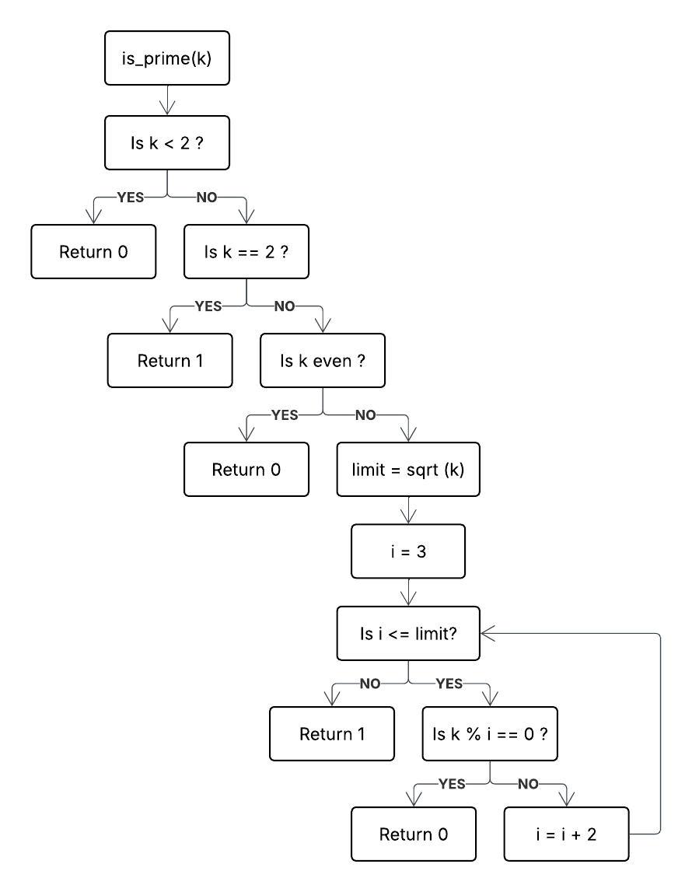
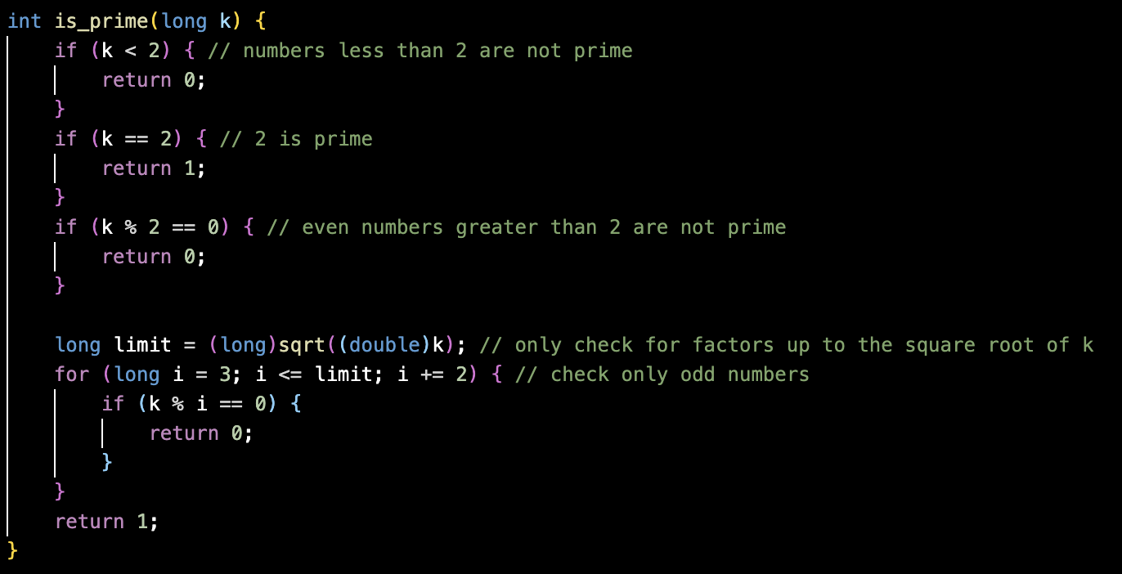
Task 1: Serial Prime Search

Slide 4
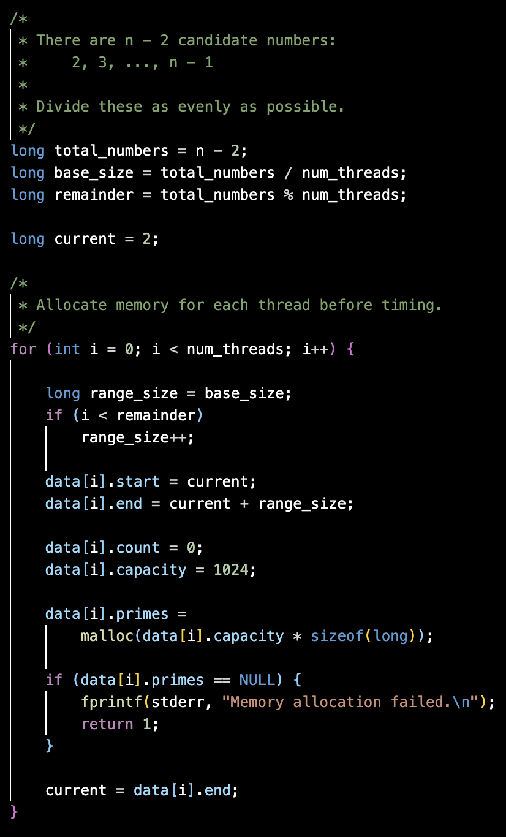
Task 2: POSIX Threads
Parallelises the prime-search loop using POSIX Threads (pthread).
The candidate range 2 ... n−1 is divided between the threads.
Each thread independently searches its assigned range.
Each thread stores its discovered primes in a private local array.
Threads are joined before results are output and execution time is recorded.

Slide 5
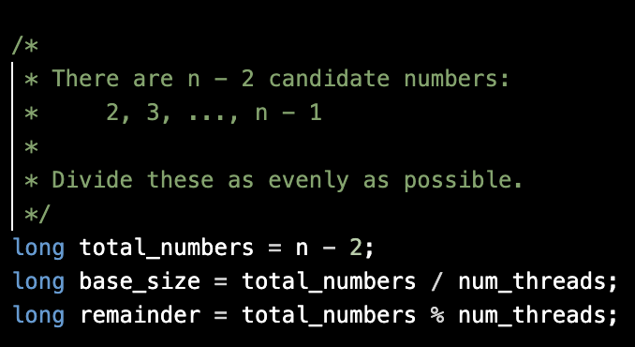
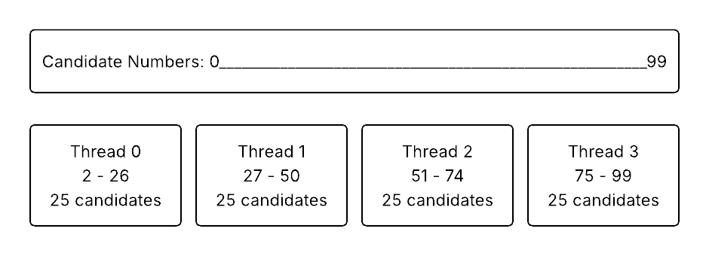
Task 2: POSIX Threads – Workload partitioning
Candidate numbers 2 ... n−1 are split into approximately equal contiguous ranges.
base_size assigns the minimum workload; any remainder is distributed among the first threads.
Each thread receives at most one more candidate than another.
Static partitioning provides a simple and balanced workload distribution.
The workload is balanced by ensuring each thread receives either ⌊(n−2)/T⌋ or ⌈(n−2)/T⌉ candidates.

Slide 6
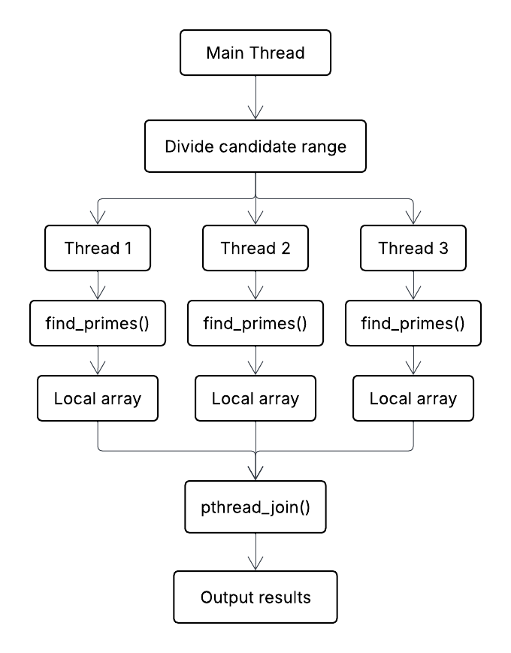
Task 2: POSIX Threads – Thread Execution
Pthread_create launches one worker for each assigned range.
Each worker executes find_primes().
pthread_join() ensures the main thread waits for all workers to finish.
Results are stored separately for each thread.
Results are output in thread/range order, so no additional sorting step is required.

Slide 7
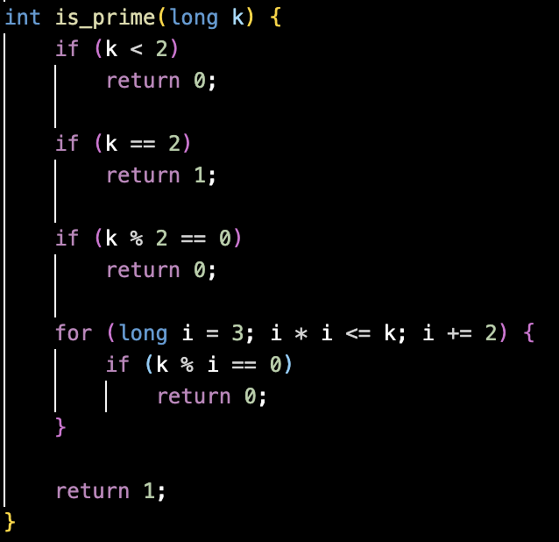
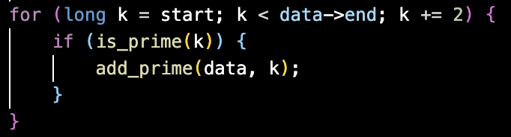
Task 2: POSIX Threads – Optimised is_prime(k)
Immediately rejects values less than 2.
Handles 2 separately as the only even prime.
Immediately rejects all other even numbers.
Checks only odd divisors up to √k.
This reduces the number of divisibility checks for each candidate.

Slide 8
Task 2: POSIX Threads – Timing
Uses clock_gettime(CLOCK_MONOTONIC, ...).
Timer starts immediately before thread creation.
Timer stops after all threads have completed.
Output/file I/O is excluded from the measured time.
This gives a fairer measurement of the parallel computation itself.

Slide 9
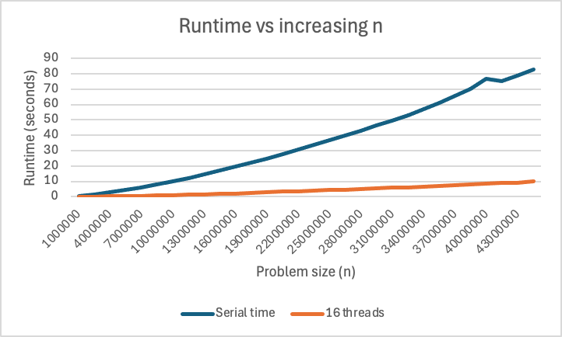
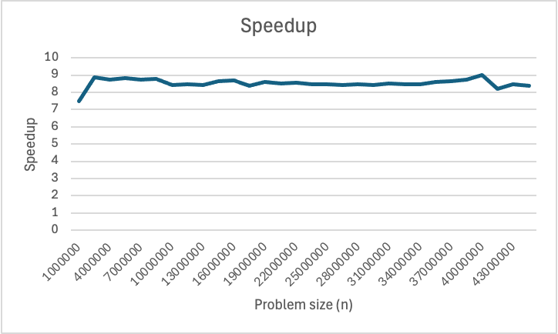
Task 2: POSIX Threads – Effect of n
As n increases, both implementations require more computation. However, the parallel implementation takes advantage of multiple threads, so its runtime grows more slowly
Speedup remains relatively stable as n increases, indicating that the parallel implementation scales consistently for the tested problem sizes
Running on Intel Core i9-9880H — 8-core CPU (16 logical processors)

Slide 10
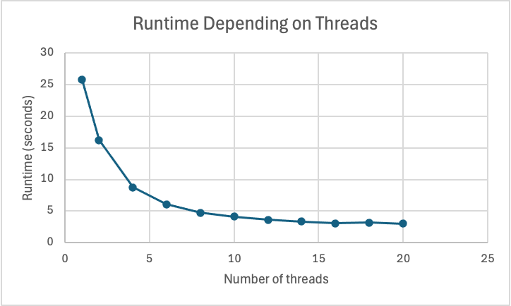
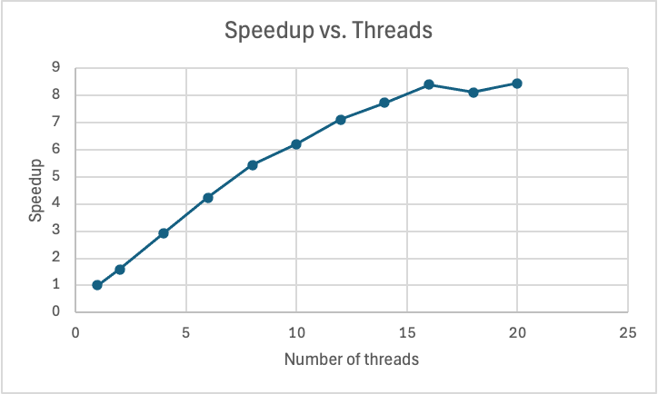
Task 2: POSIX Threads – Effect of thread count
Average runtime decreases as we increase the no. of threads. Increasing the number of threads has a greater impact at lower thread counts.
Speedup increases steadily with thread count, but shows diminishing gains once the number of threads exceeds the available CPU cores.
Running on Intel Core i9-9880H — 8-core CPU (16 logical processors)

Slide 11
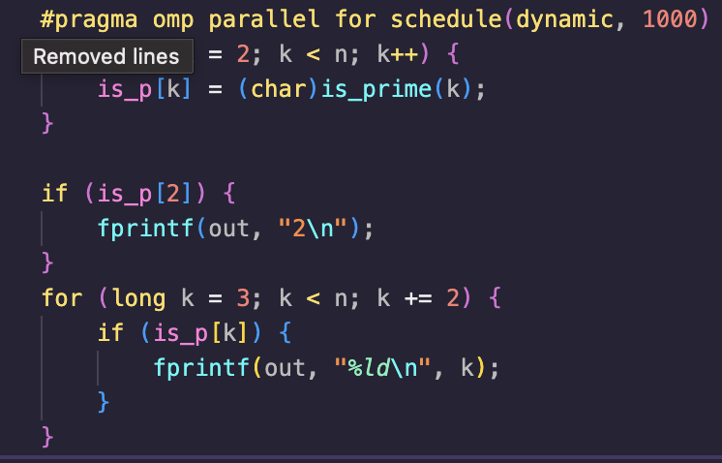
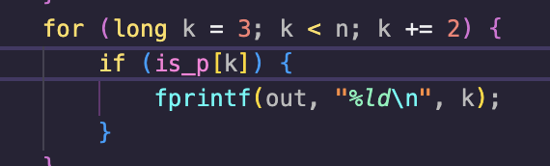
Task 3: OpenMP
Each thread goes in a queue to get a chunk of size 1000 to process.
The work is independent of other threads, meaning we can simply use the is_prime function unchanged on that range of numbers.
We store primes in a direct-address table. (each index represents the prime, and we can set it to 0 or 1 depending on if it is a prime or not)
We loop through this array to execute the output.
Slight space efficiency cost (having to store an array of size sqrt(n))

Slide 12
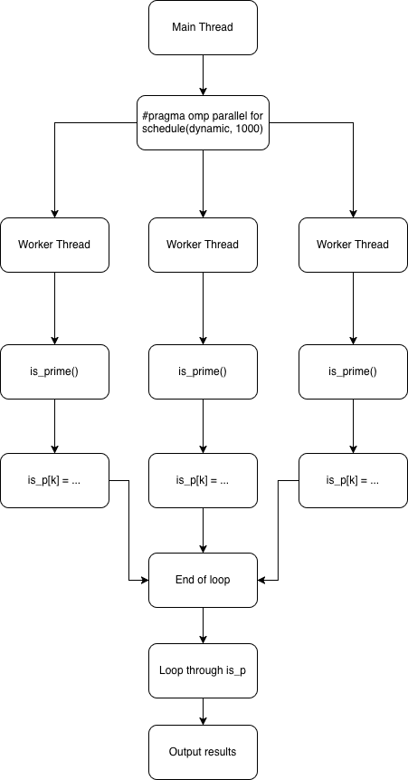
Task 3: OpenMP syncronisation handling
Splits work (2, sqrt(n)) into chunks of 1000 size
As we are dynamically partitioning, as opposed to statically partitioning (Task 2), it is more difficult to synchronize the output in order
This allows us to not worry about synchronisation too much as positions in the array can be adjusted without caring about order, the order will be handled by a loop at the end.
Notes:
The POSIX threads code can be synchronized, as each thread has a dedicated partition statically defined, as the number of threads is defined beforehand, and you can stitch the output by taking each thread’s output in the order of what range they worked on. OpenMP has a harder time with this, as schedule(dynamic, 1000) assigns work in a queue system, assigning the 1000 number work dynamically to threads, which can be hard to syncronise.

Slide 13
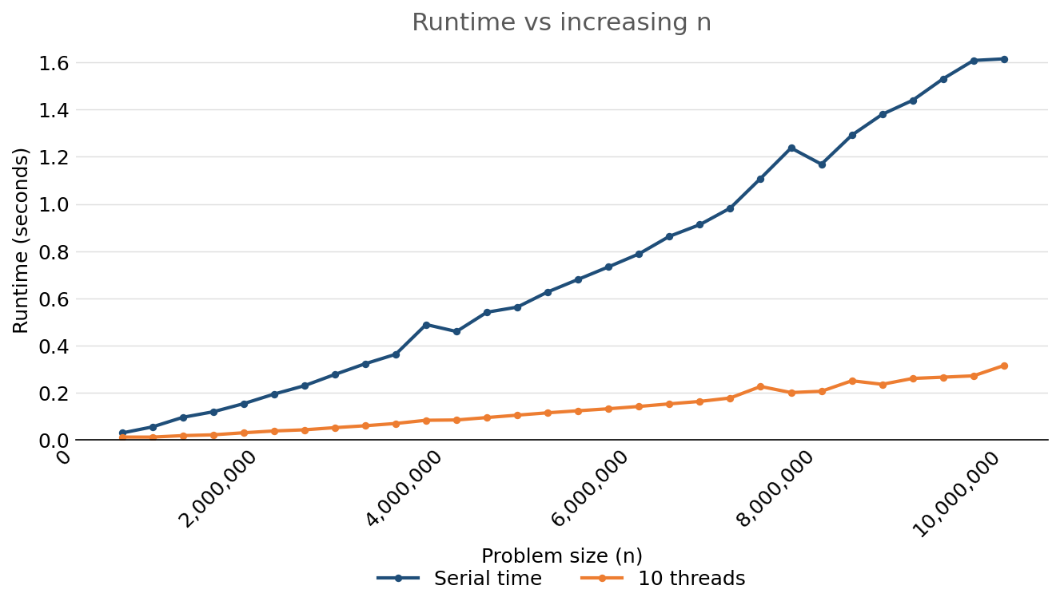
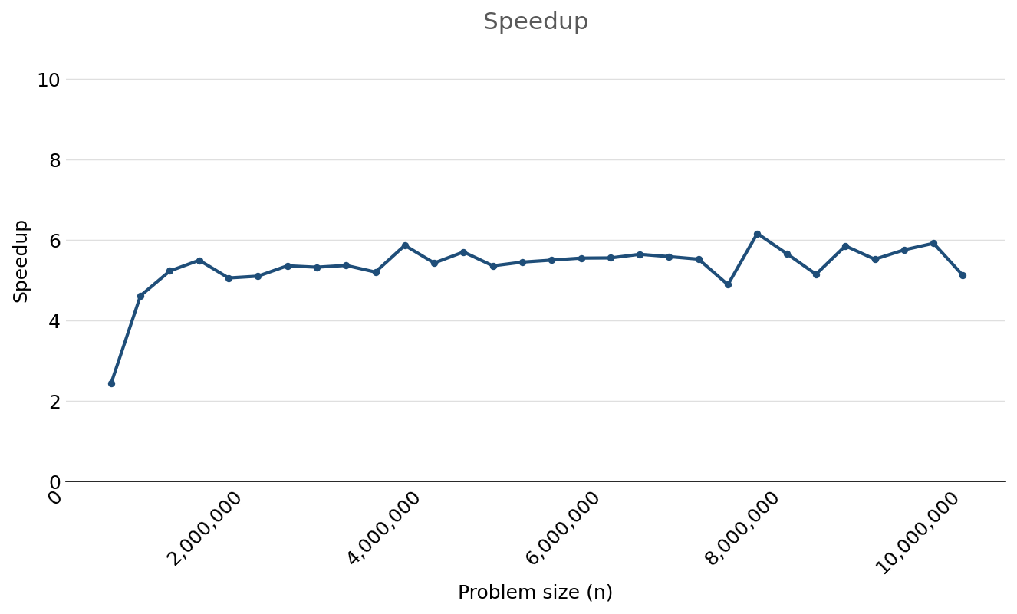
OpenMP - Comparison to serial & Effect of n
Running on Apple M5 (10 core: 4 super, 6 efficiency)
Tested on values: 500,000 827,586 1,155,172 1,482,759 1,810,345, 2,137,931 2,465,517 2,793,103 3,120,690 3,448,276, 3,775,862 4,103,448 4,431,034 4,758,621 5,086,207, 5,413,793 5,741,379 6,068,966 6,396,552 6,724,138, 7,051,724 7,379,310 7,706,897 8,034,483 8,362,069, 8,689,655 9,017,241 9,344,828 9,672,414 10,000,000

Slide 14
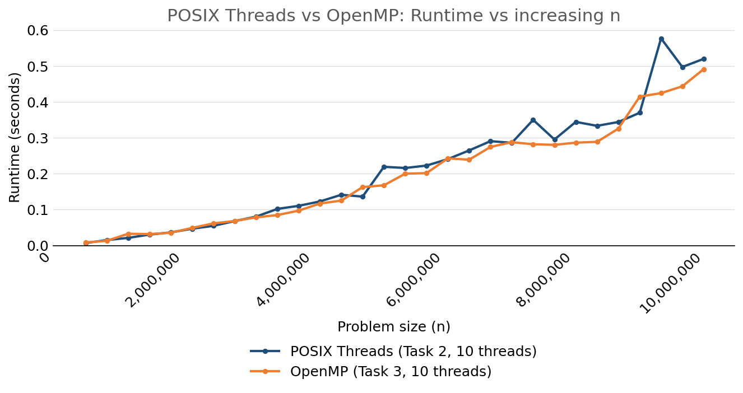
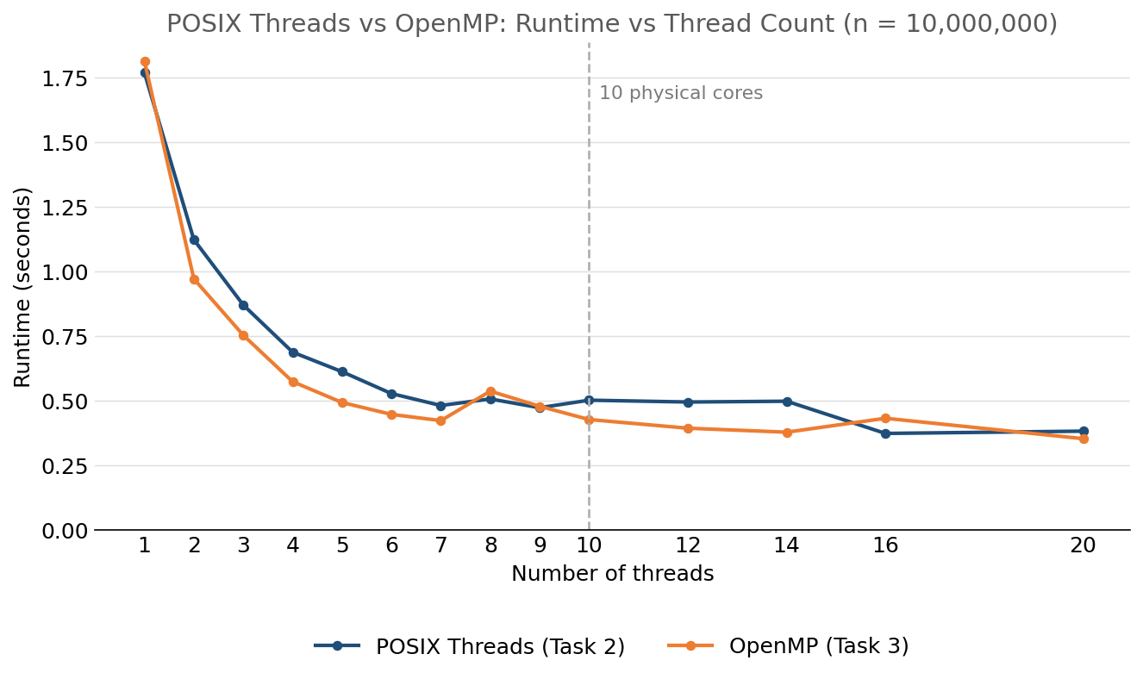
Comparison between POSIX threads & OpenMP implementation
Running on Apple M5 (10 core: 4 super, 6 efficiency)

Slide 15
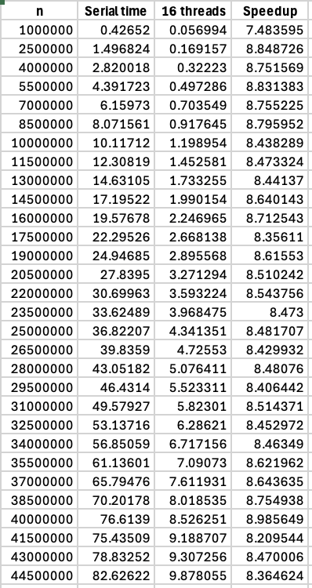
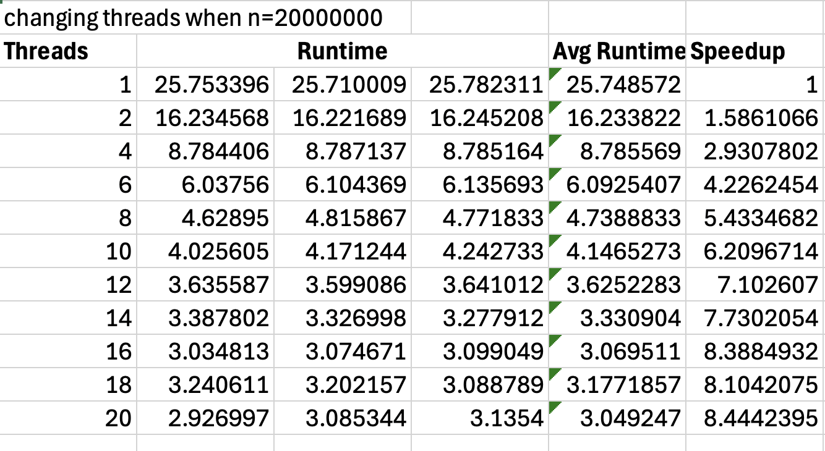
Raw data for Task 2

